Slide 1


Ensemble Learning with Morphological Processing for Cell Edge Detection
Xinran Dong
2301210603

Slide 2
Content
Introduction
Pre-processing
Architecture
Training
Post-processing
Result
Conclusion

Slide 3
Introduction
Ultra-high Resolution Scanning Electron Microscope (SEM) Images Segmentation Challenge is a competition hosted by BAAI and PKU, which provides many high-resolution SEM mouse retinal neurons with per-pixel level annotation for boundary segmentation.
There are two tracks in the competition: the Simple one and the Complex one:
The Simple track has fewer cell counts, smaller image size, lower resolution and fewer pixels on the cell membrane.
The Complex track has more cell counts, larger image size, higher resolution and more pixels on the cell membrane.

Slide 4
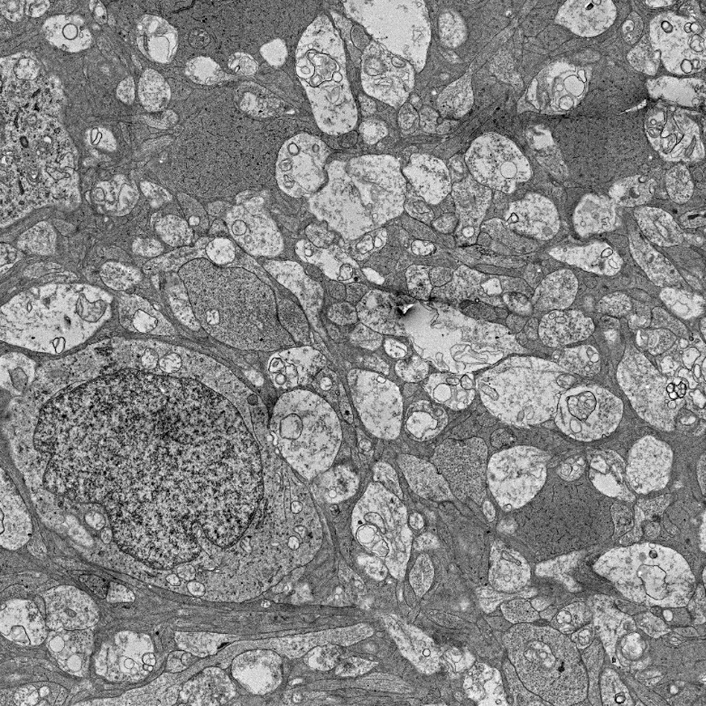
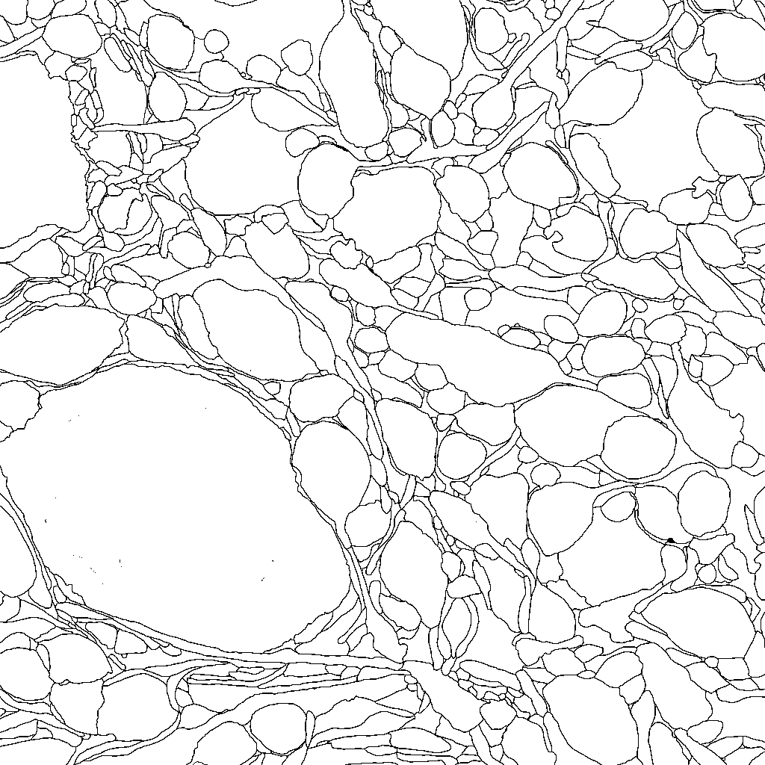
Introduction
Due to the limitation of computing resources, we choose the Simple track, which is actually more difficult because of the extremely small amount of training data.
There are 30 training images, 9 validation images (10 originally but containing a mismatched image and label pair) and 30 test images, the resolution of each image and label is 1024×1024.
image
label

Slide 5
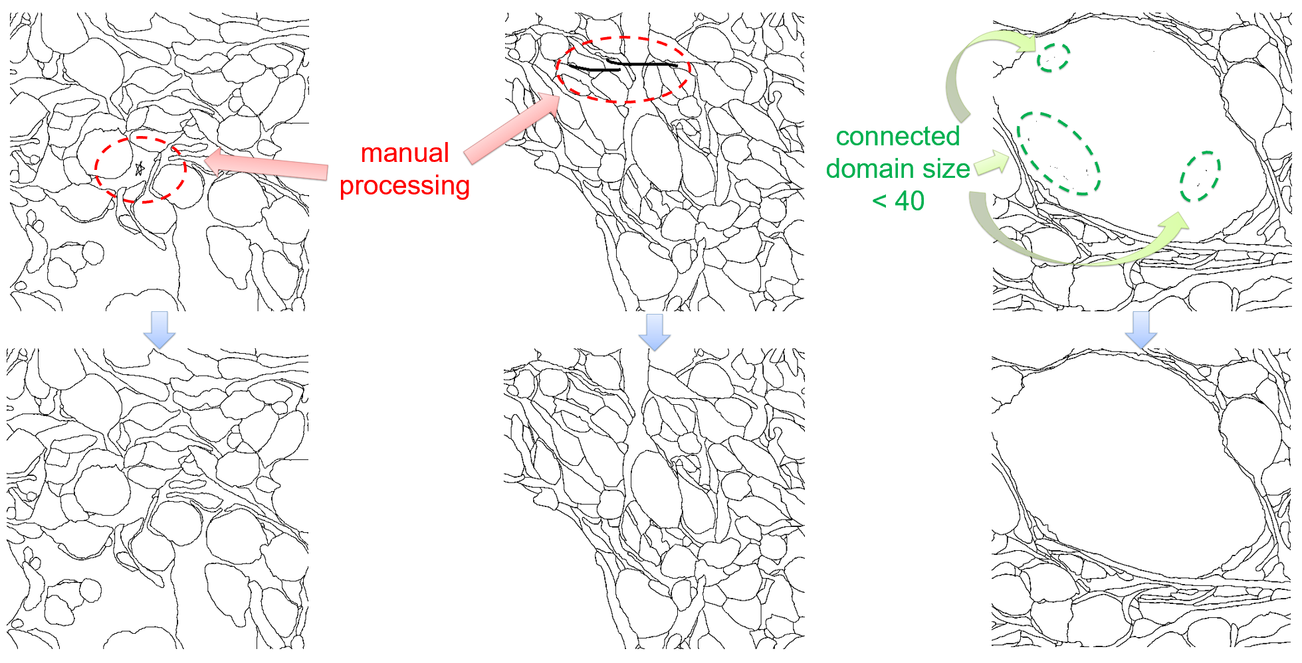
Pre-processing: denoising
Like other datasets, the raw data in the U-RISC dataset contains a lot of noise, including large areas of mislabeling and small noise points.
Since data quality determines the upper limit of model performance, we do the denoising before training.
For errors with large area and difficult to be processed by morphological method, we use manual processing to remove them.
For the noise points with small local area, we directly remove the area whose connected domain size < 40.

Slide 6
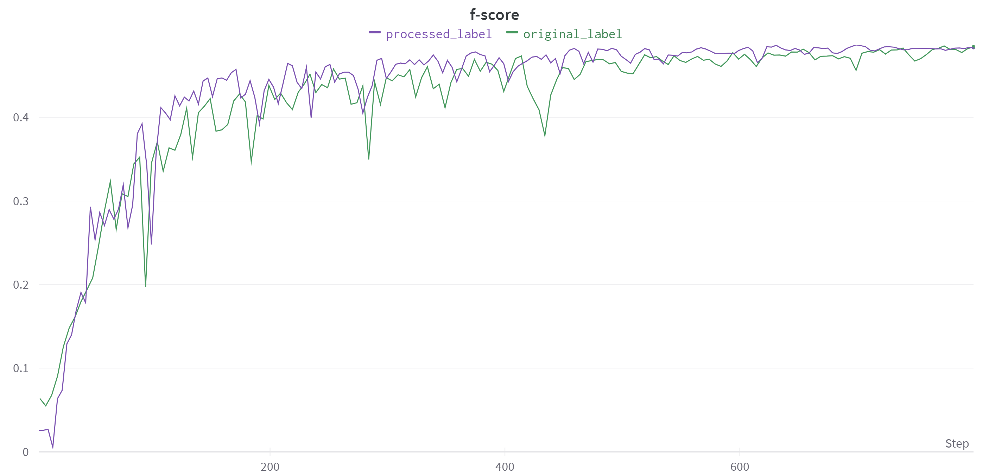
Pre-processing: denoising

Slide 7
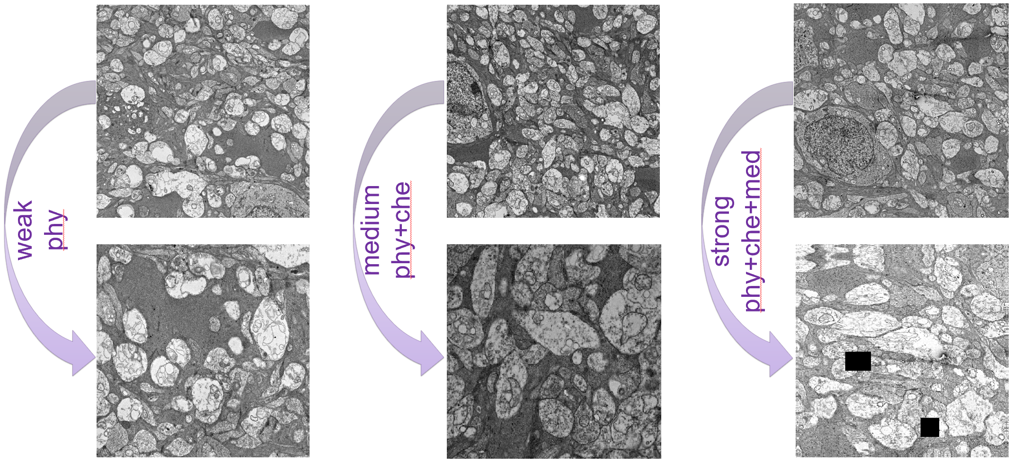
Pre-processing: augmentation
Due to the lack of training data in simple track, we adopt a series of physical and chemical transformations for strong data augmentation in order to avoid overfitting.
Physical: RandomResizedCrop, HorizontalFlip, VerticalFlip, RandomRotate90
Chemical: RandomBrightnessContrast, MultiplicativeNoise
Medical: ElasticTransform, GridDistortion, OpticalDistortion, CoarseDropout
The augmentation transforms are from https://github.com/albumentations-team/albumentations

Slide 8
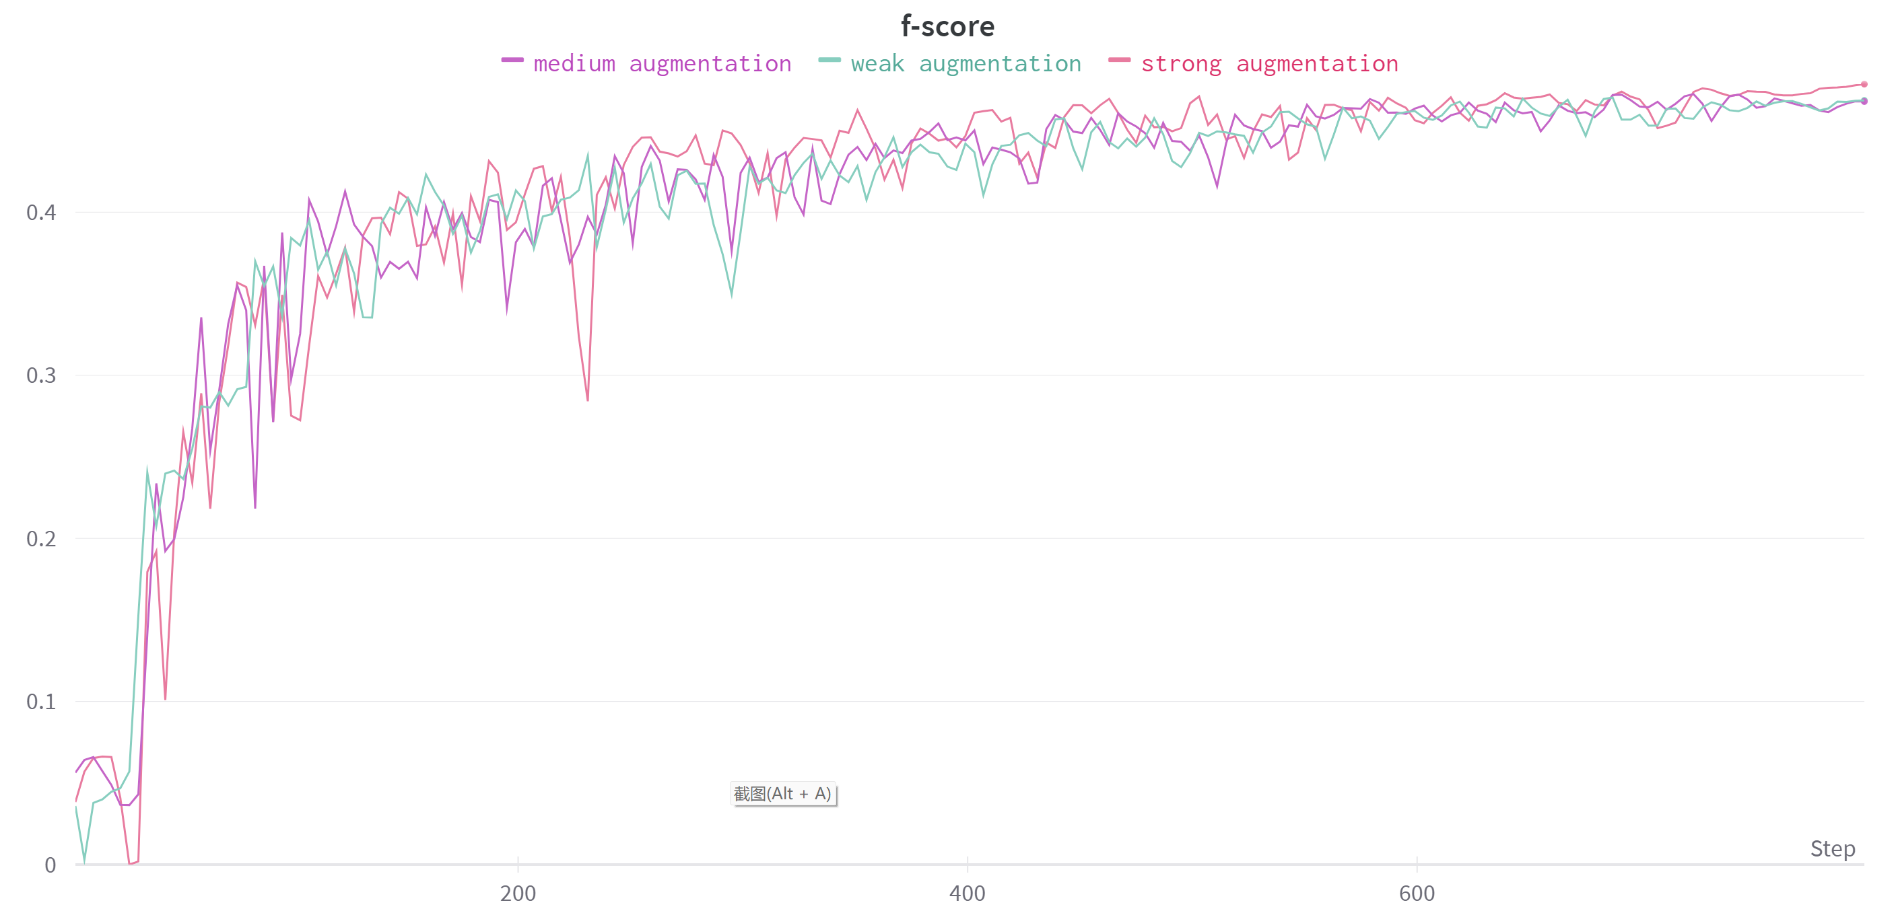
Pre-processing: augmentation

Slide 9
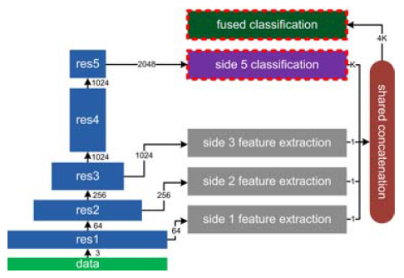
Architecture-CASENet
Yu, Zhiding, et.al "CASENet: Deep Category-Aware Semantic Edge Detection", CVPR 2017

Slide 10
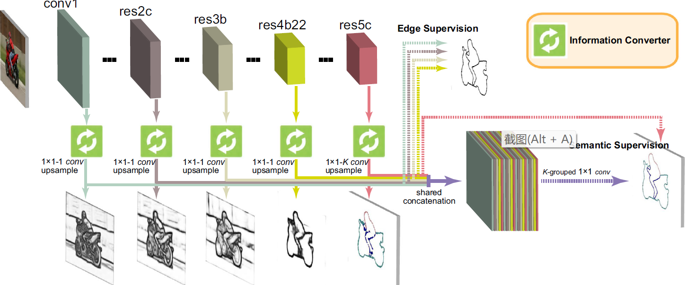
Architecture-DDS
Yun, Liu, et.al "Semantic Edge Detection with Diverse Deep Supervision", PAMI 2018

Slide 11
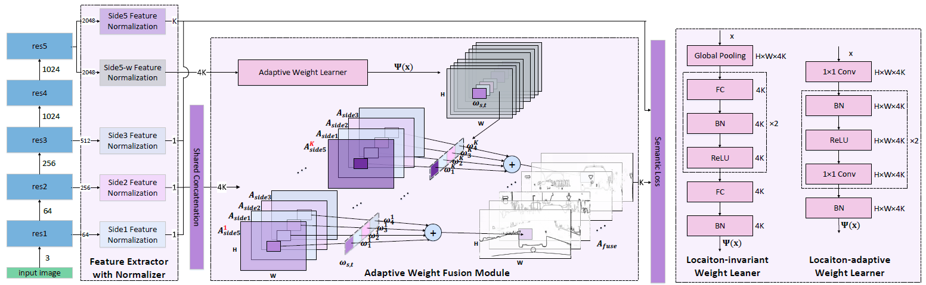
Architecture-DFF
Hu, Yuan, et.al "Dynamic Feature Fusion for Semantic Edge Detection", AAAI 2019

Slide 12
Architecture
We use a pretrained ResNet-50 as backbone for all network structures.
We also use model ensemble to improve robustness which is very important in the medical field.

Slide 13
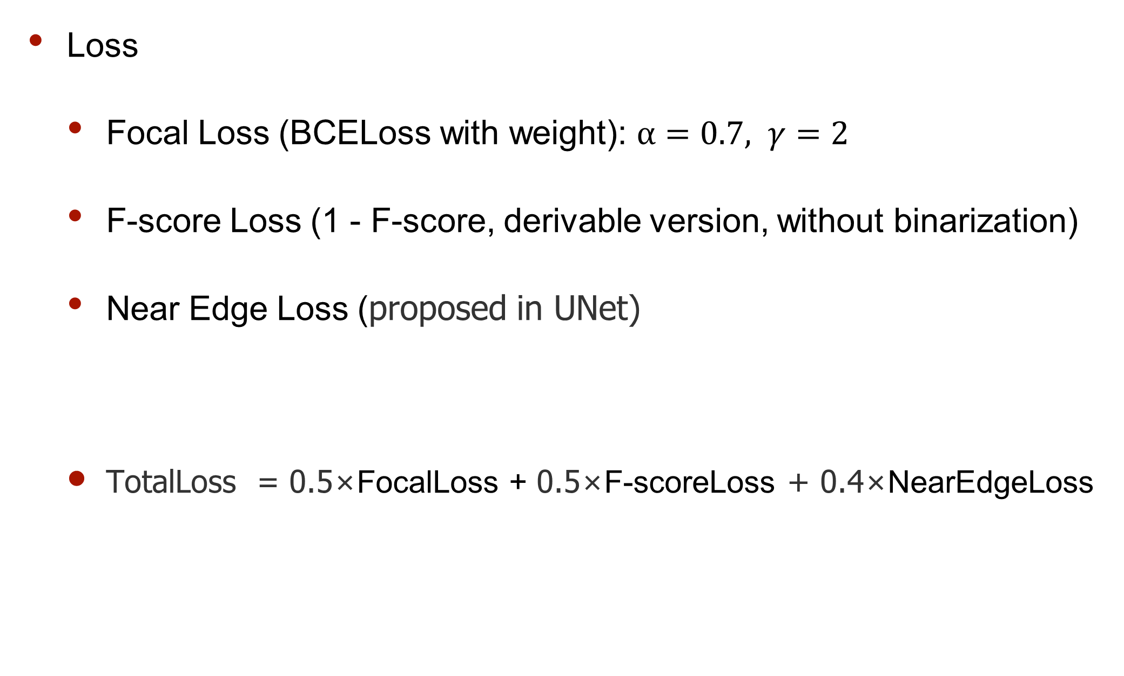
Training
Loss
Focal Loss (BCELoss with weight): $α=0.7, γ=2$
F-score Loss (1 - F-score, derivable version, without binarization)
Near Edge Loss (proposed in UNet)
TotalLoss = 0.5×FocalLoss + 0.5×F-scoreLoss + 0.4×NearEdgeLoss

Slide 14
Training
Setting
Optimizer: Adam
Learning rate: backbone 0.004, other 0.04
Batch size: 12
Epoch: 200
GPU: 4 NVIDIA 2080Ti (12GB memory each)
AMP: True

Slide 15
Training
Other hyperparameter
Crop size: 512×512
Pre-process binarization threshold: 122
Post-process binarization threshold: 127.5

Slide 16
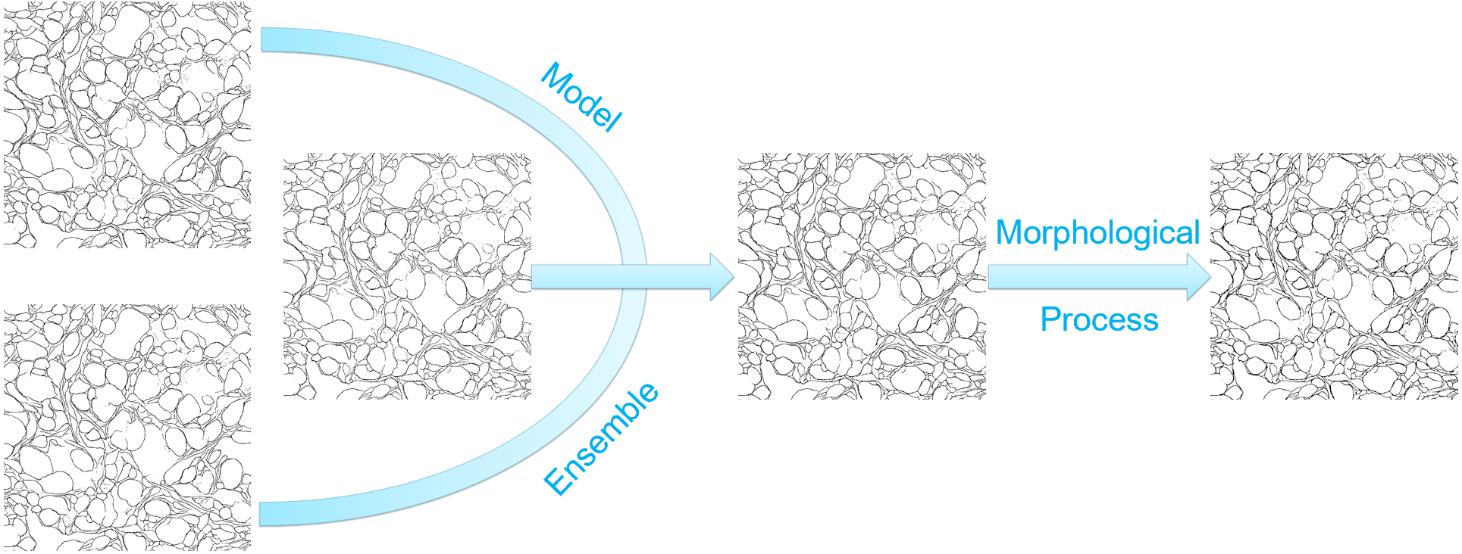
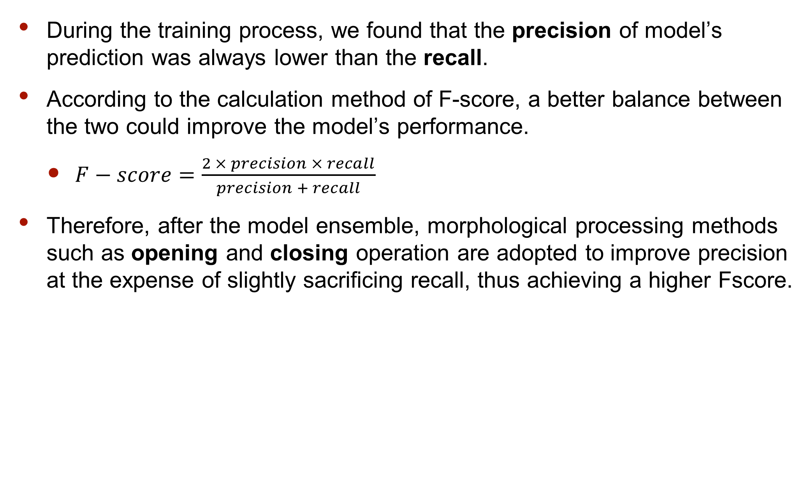
Post-processing: morphological processing
During the training process, we found that the precision of model’s prediction was always lower than the recall.
According to the calculation method of F-score, a better balance between the two could improve the model’s performance.
$F−score=\frac{2 × precision × recall}{precision + recall}$
Therefore, after the model ensemble, morphological processing methods such as opening and closing operation are adopted to improve precision at the expense of slightly sacrificing recall, thus achieving a higher Fscore.

Slide 17
Result
The worst of the three models above outperforms previous state-of-the-art method (F-score=0.47411), and the best one by a significant margin (more than 0.02 F-score) on the validation set.
Our model hasn’t been saturated even after 500 epochs of training, which demonstrates the potential of our approach and the effectiveness of out strong data augmentation.
Model | Epoch | F-score
CASENet | 200 | 0.48099
DDS | 200 | 0.47982
DFF | 200 | 0.48982
DFF | 500 | 0.49489

Slide 18
Conclusion
Contribution
We are the first to use a combination of neural networks and morphological processing to do EM cytomembrane segmentation.
We use strong data augmentation to avoid overfitting in the small dataset, model ensemble to improve robustness which is very important in the medical field and morphological processing to improve the precision at the expense of slightly sacrificing the recall.
We outperform previous state-of-the-art methods by a significant margin on U-RISC dataset (more than 0.02 F-score on val set).

Slide 19
Conclusion
Improvement
Add more morphological processing in the preprocessing stage to help the neural network extract image features better.
Adopt two-stage or cascade network structure to better classify details.

Slide 20
Thanks for listening!

